Slide 1




Wind Energy Harvesting with a Kite
Antonin Bavoil¹, Jean-Baptiste Caillau¹, Lamberto Dell’Elce², Alain Nême³ , Jean-Baptiste Leroux³
1: Université Côte d’Azur, CNRS, Inria, LJAD
2: Inria
3: ENSTA Bretagne, iRDL
FGS Conference on Optimization
Gijón, June 2024

Slide 2
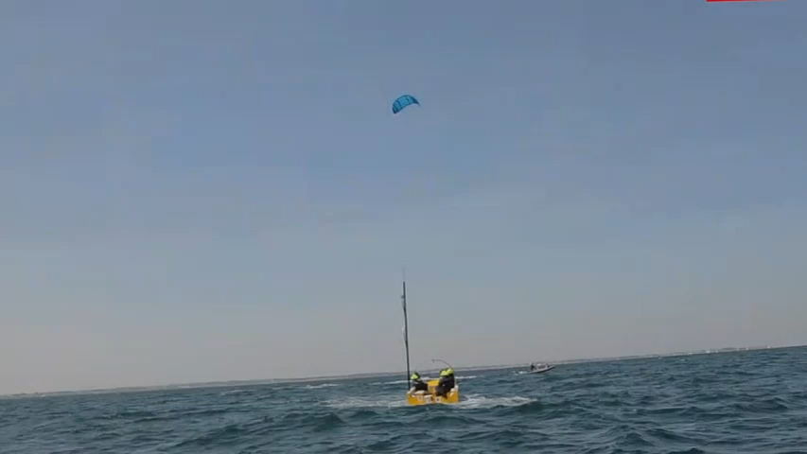
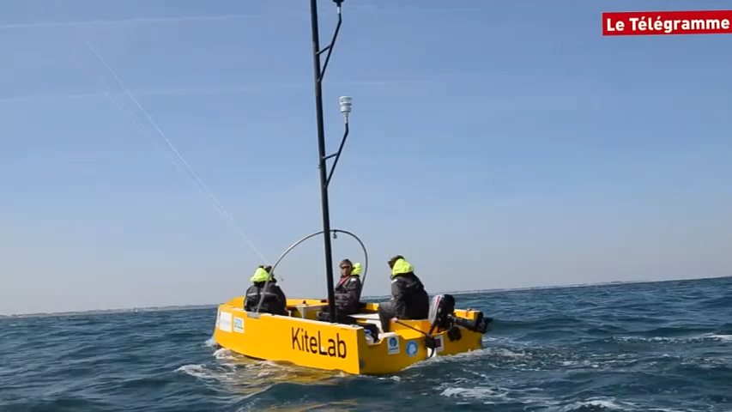
Kite Electrical Energy Production (KEEP)
KEEP is born as a follow up of Beyond the Sea®.
Idea: generate (on land) electricity with a kite.
10x less material than a wind turbine, soft.
Portable source of power in remote areas.
➝ Islands, military.
https://www.dailymotion.com/video/x5fwyox

Slide 3
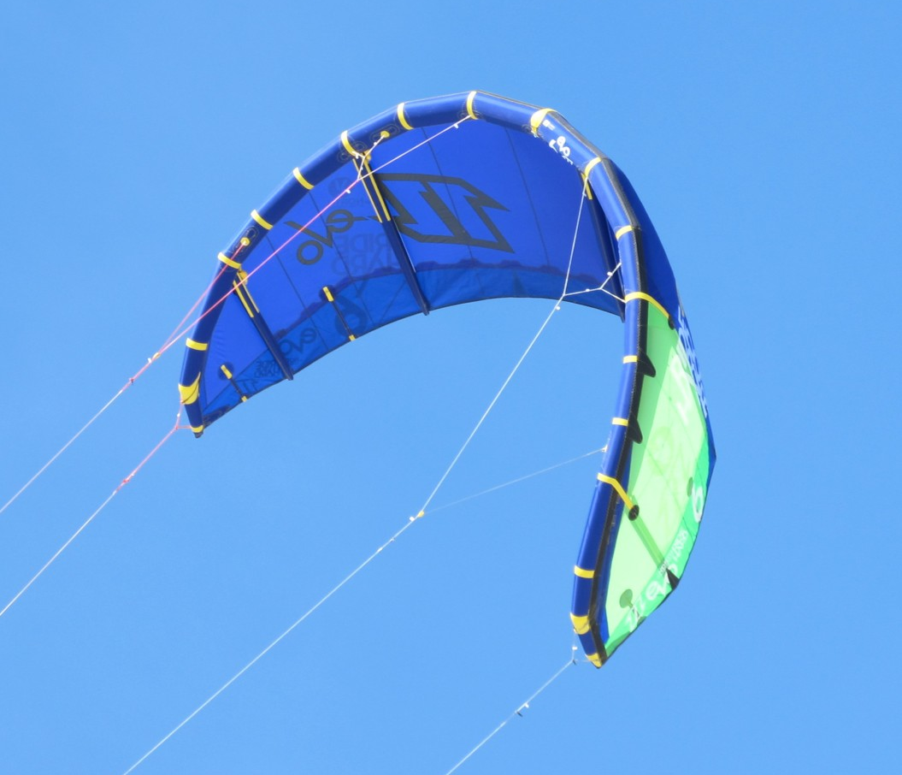
Kite Electrical Energy Production (KEEP)
Approximately the same power as a wind turbine.
Currently: 10% of the production used for control.
Previous works:
U. Ahrens, M. Diehl, R. Schmehl. Airborne Wind Energy. Springer, 2013,
U. Fechner et al. Dynamic Model of a Pumping Kite Power System, Pergamon, 2015.
➝ Can we generate a good amount of electricity while requiring close to no control?
https://www.iksurfmag.com/reviews/kites/north-kiteboarding-evo-6m-2013/

Slide 4
Wind Energy Harvesting with a Kite
Modelling
Numerical Results
Optimization

Slide 5
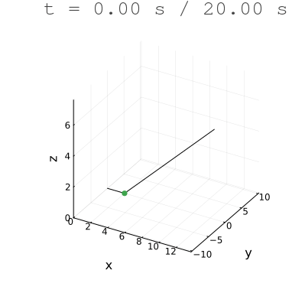
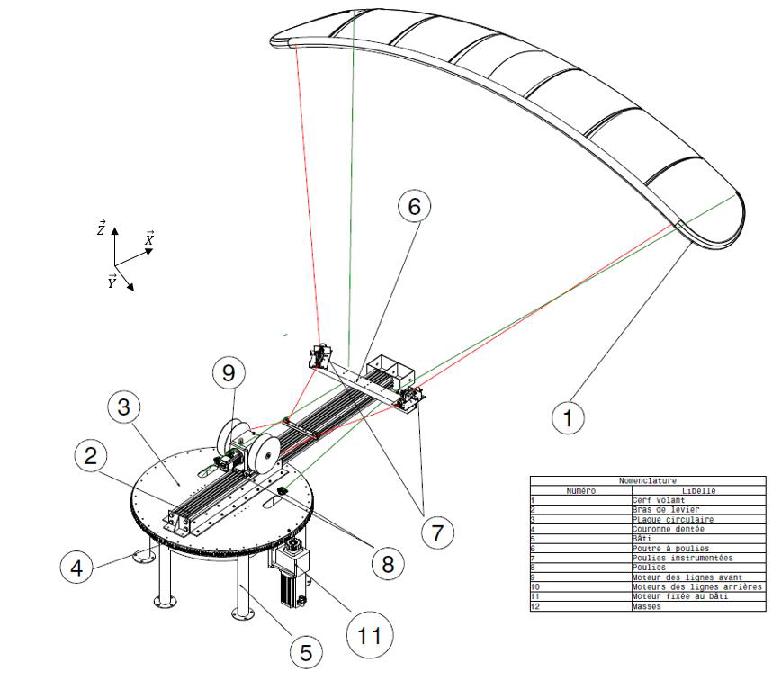
Modelling
➝ The kite does eights in the sky to swing the arm left to right as much as possible, without tangling the lines.

Slide 6
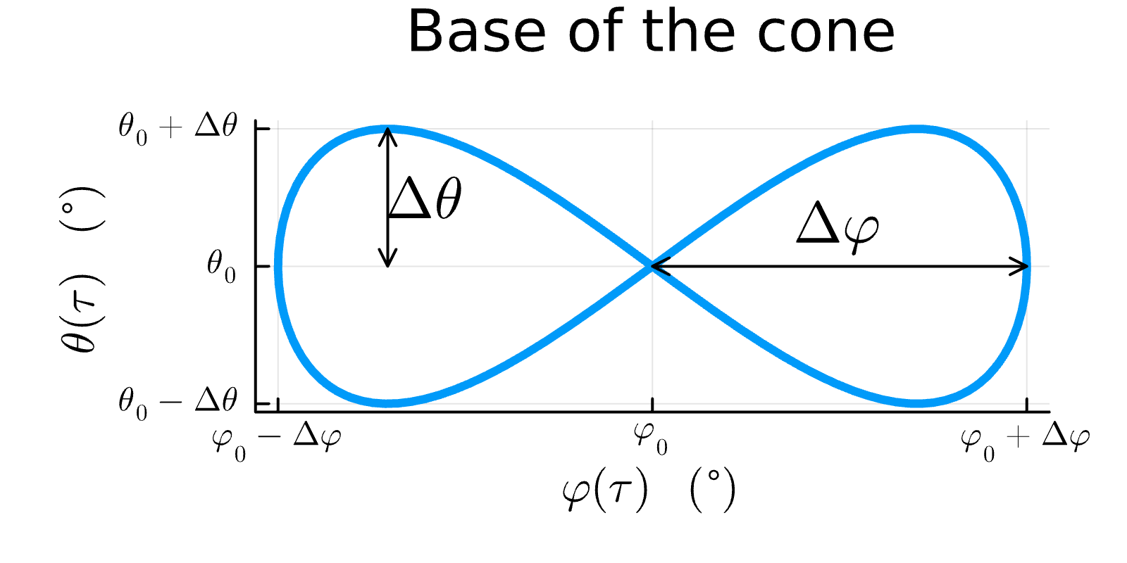
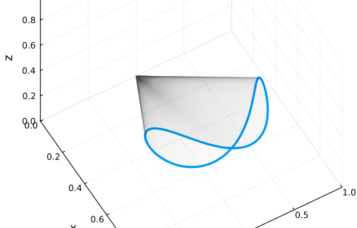
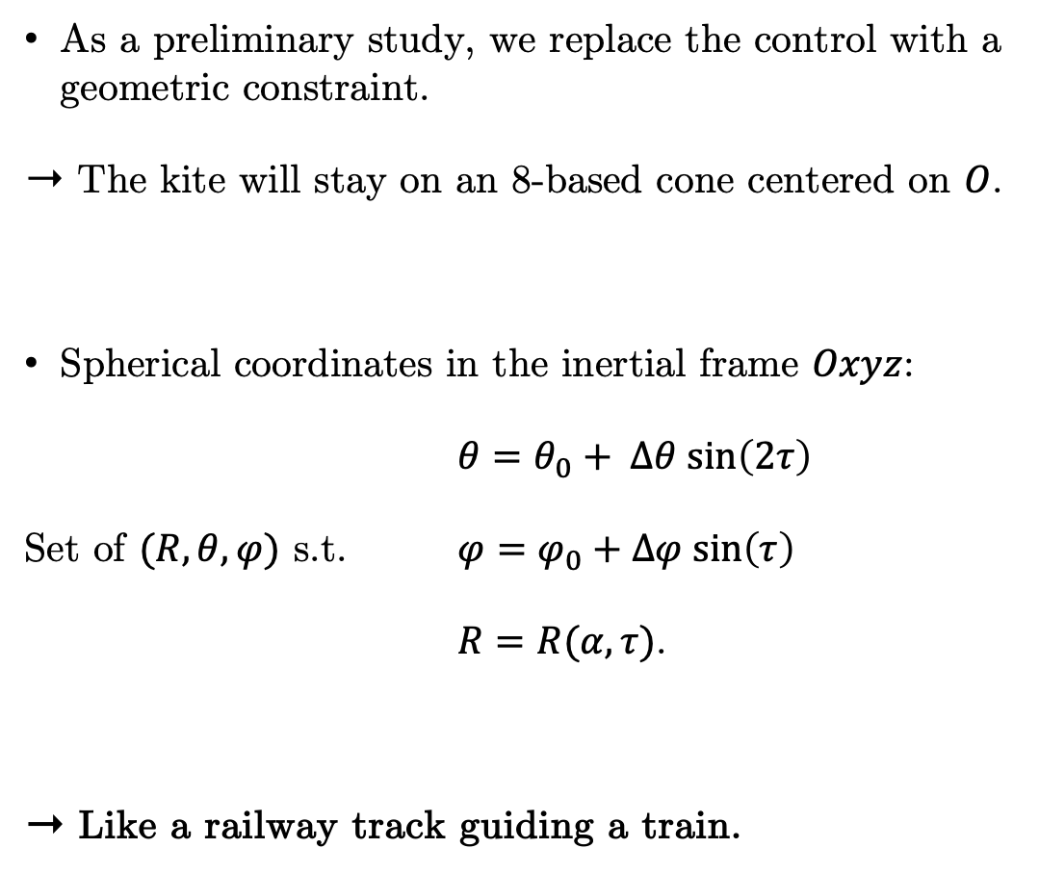
Modelling
Replacing the control with an algebraic constraint
As a preliminary study, we replace the control with a geometric constraint.
➝ The kite will stay on an 8-based cone centered on $O$.
Spherical coordinates in the inertial frame $Oxyz$:
$θ=θ_{0}+ Δθ sin\left(2τ\right)$
Set of $(R, θ, φ)$ s.t. $φ=φ_{0}+Δφ sin\left(τ\right)$
$R=R(α, τ)$.
➝ Like a railway track guiding a train.

Slide 7

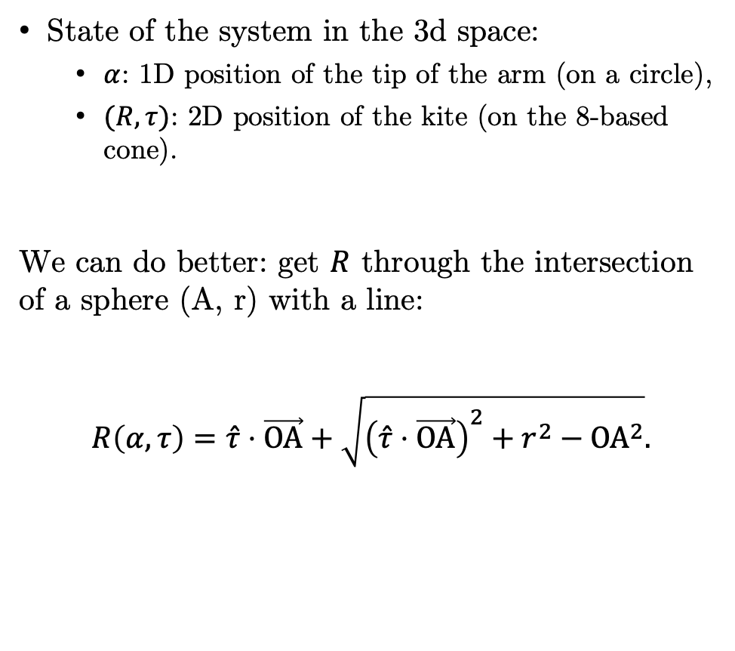
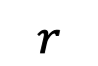
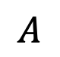
Modelling
Coordinates
State of the system in the 3d space:
$α$: 1D position of the tip of the arm (on a circle),
$(R, τ)$: 2D position of the kite (on the 8-based cone).
We can do better: get $R$ through the intersection of a sphere (A, r) with a line:
$$R\left(α, τ\right)=\hat{τ}⋅\vec{OA}+\sqrt{{\left(\hat{τ}⋅\vec{OA}\right)}^{2}+r^{2}−{OA}^{2}}.$$
+
$$R?$$
$$A$$
$$r$$
➝ $(α, τ)$ is enough to determine the state of the system.

Slide 8
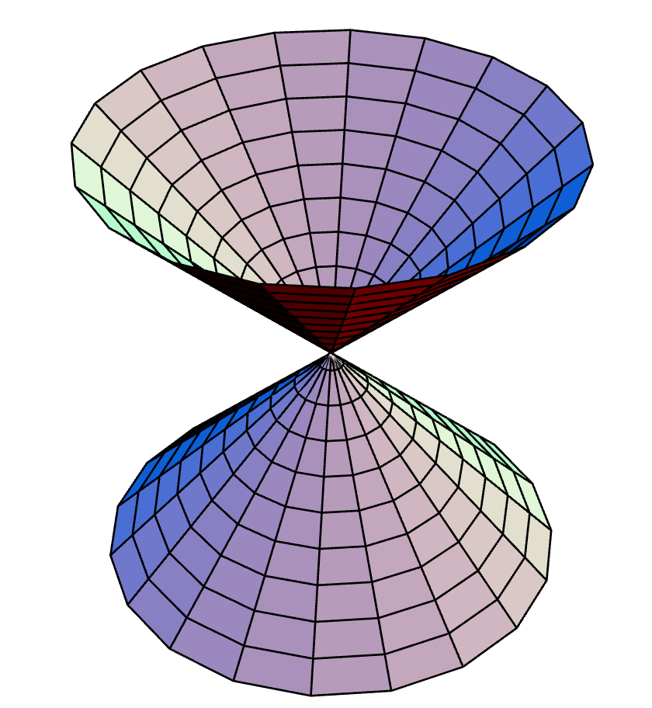
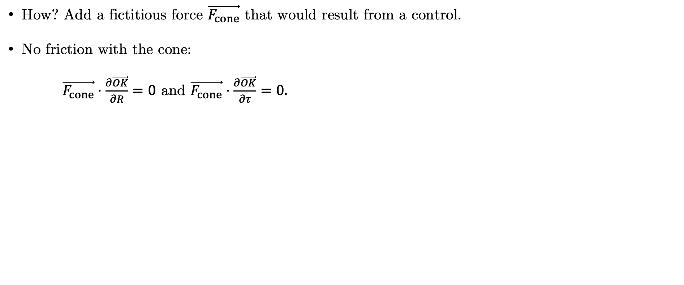
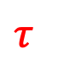

Modelling
Replacing the control with an algebraic constraint
How? Add a fictitious force $\vec{F_{cone}}$ that would result from a control.
No friction with the cone:
$\vec{F_{cone}}⋅\frac{∂\vec{OK}}{∂R}=0$ and $\vec{F_{cone}}⋅\frac{∂\vec{OK}}{∂τ}=0.$
Circle-based cone
$$R$$
$$τ$$
https://mathworld.wolfram.com/Cone.html

Slide 9

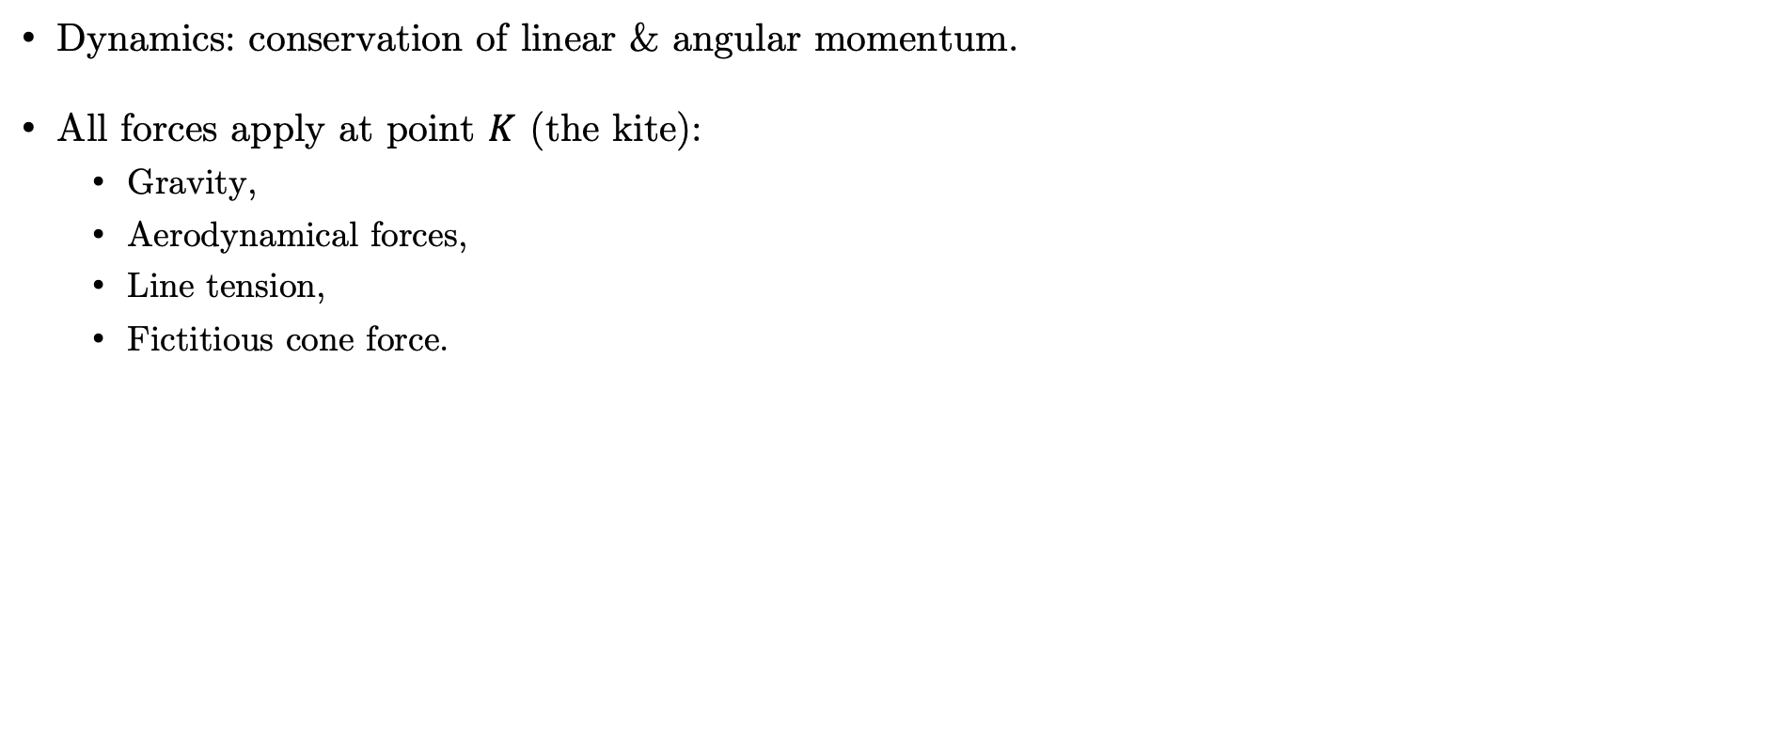


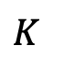
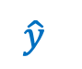
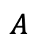

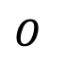
Modelling
Compute the dynamics
Dynamics: conservation of linear & angular momentum.
All forces apply at point $K$ (the kite):
Gravity,
Aerodynamical forces,
Line tension,
Fictitious cone force.
$$\hat{z}$$
Kite
$$K$$
Wind
$$R$$
Lines
$$\hat{y}$$
Generator
Arm
$$O$$
$$A$$
$$\hat{x}$$
$$α$$

Slide 10
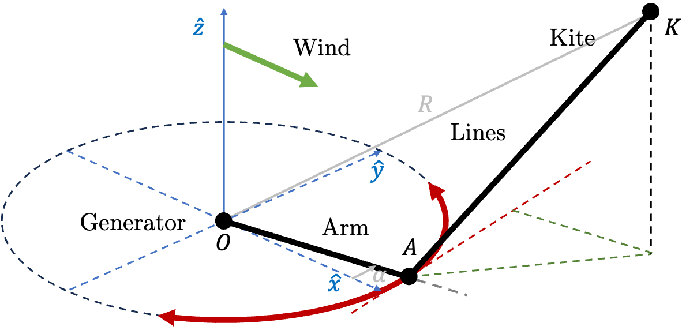
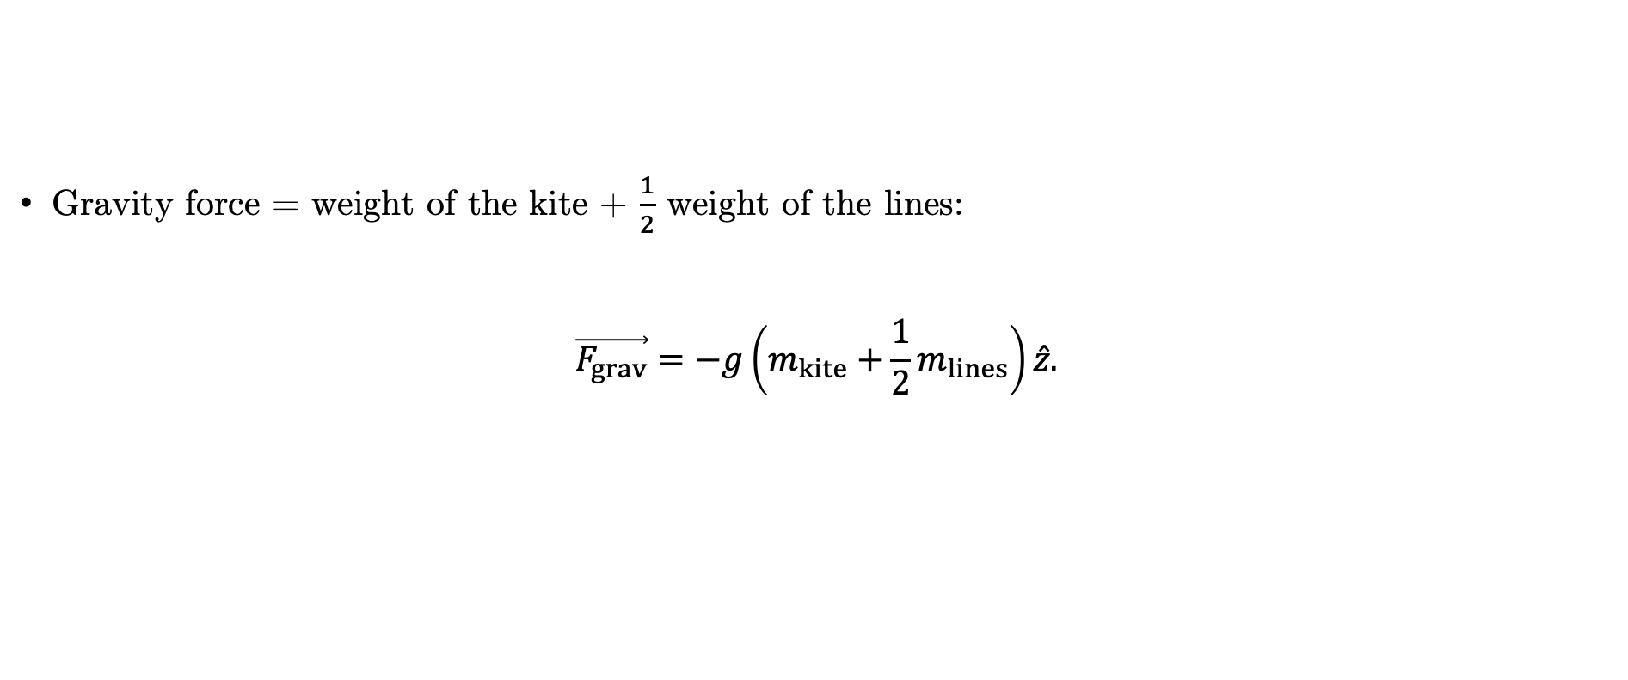
Modelling
Gravity
Gravity force = weight of the kite + $\frac{1}{2}$ weight of the lines:
$$\vec{F_{grav}}=−g\left(m_{kite}+\frac{1}{2}m_{lines}\right)\hat{z}.$$

Slide 11
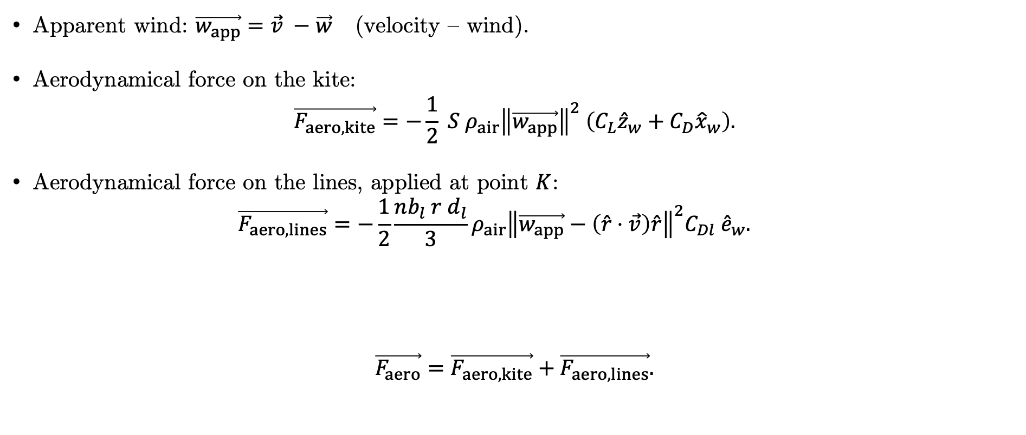
Modelling
Aerodynamical forces
Apparent wind: $\vec{w_{app}}=\vec{v} −\vec{w}$ (velocity – wind).
Aerodynamical force on the kite:
$$\vec{F_{aero, kite}}=−\frac{1}{2} S {ρ_{air}\left\|\vec{w_{app}}\right\|}^{2} \left({C_{L}{\hat{z}}_{w}+C}_{D}{\hat{x}}_{w}\right).$$
Aerodynamical force on the lines, applied at point $K$:
$$\vec{F_{aero,lines}}=−\frac{1}{2}\frac{nb_{l} r d_{l}}{3}ρ_{air}{\left\|\vec{w_{app}}−\left(\hat{r}⋅\vec{v}\right)\hat{r}\right\|}^{2}C_{Dl} {\hat{e}}_{w}.$$
$$\vec{F_{aero}}=\vec{F_{aero, kite}}+\vec{F_{aero, lines}}.$$

Slide 12
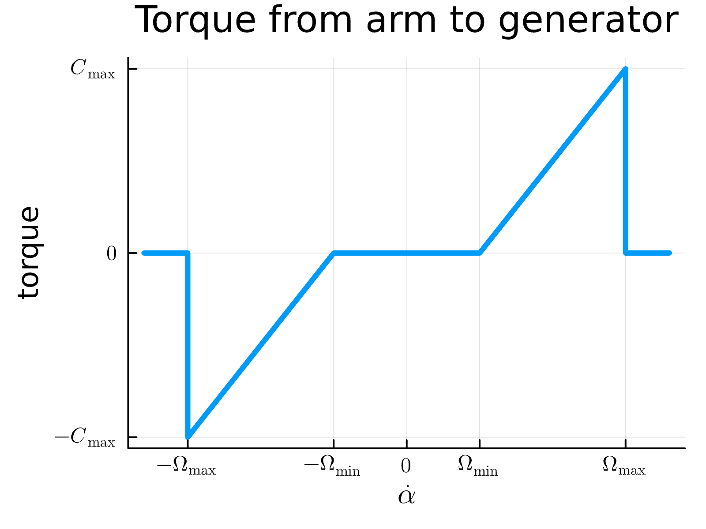
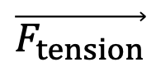
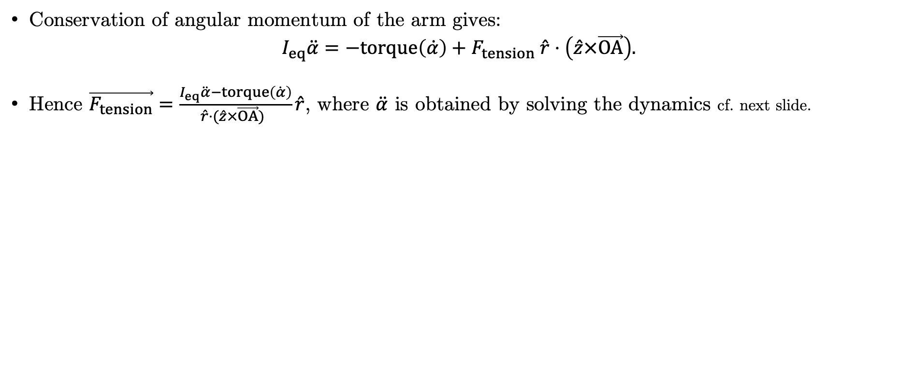

Modelling
Line tension & conservation of angular momentum
Conservation of angular momentum of the arm gives:
$$I_{eq}\ddot{α}=−torque\left(\dot{α}\right)+F_{tension} \hat{r}⋅\left(\hat{z}×\vec{OA}\right).$$
Hence $\vec{F_{tension}}=\frac{I_{eq}\ddot{α}−torque\left(\dot{α}\right)}{\hat{r}⋅(\hat{z}×\vec{OA}) }\hat{r}$, where $\ddot{α}$ is obtained by solving the dynamics cf. next slide.
$$\vec{F_{tension}}$$
$$\hat{r}$$

Slide 13
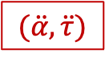
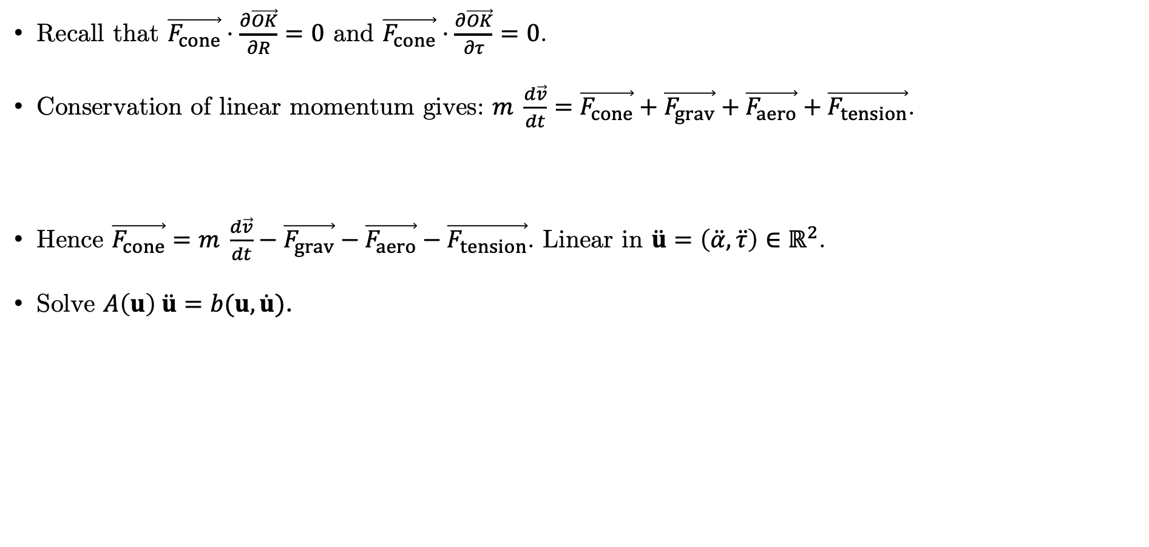

Modelling
Computing the explicit dynamics
Recall that $\vec{F_{cone}}⋅\frac{∂\vec{OK}}{∂R}=0$ and $\vec{F_{cone}}⋅\frac{∂\vec{OK}}{∂τ}=0$.
Conservation of linear momentum gives: $m \frac{d\vec{v}}{dt}=\vec{F_{cone}}+\vec{F_{grav}}+\vec{F_{aero}}+\vec{F_{tension}}$.
Hence $\vec{F_{cone}}=m \frac{d\vec{v}}{dt}−\vec{F_{grav}}−\vec{F_{aero}}−\vec{F_{tension}}$. Linear in $\ddot{u}=\left(\ddot{α}, \ddot{τ}\right)∈ℝ^{2}$.
Solve $A\left(u\right) \ddot{u}=b(u,\dot{u})$.
$$(\ddot{α}, \ddot{τ})$$
$$\ddot{α}$$

Slide 14
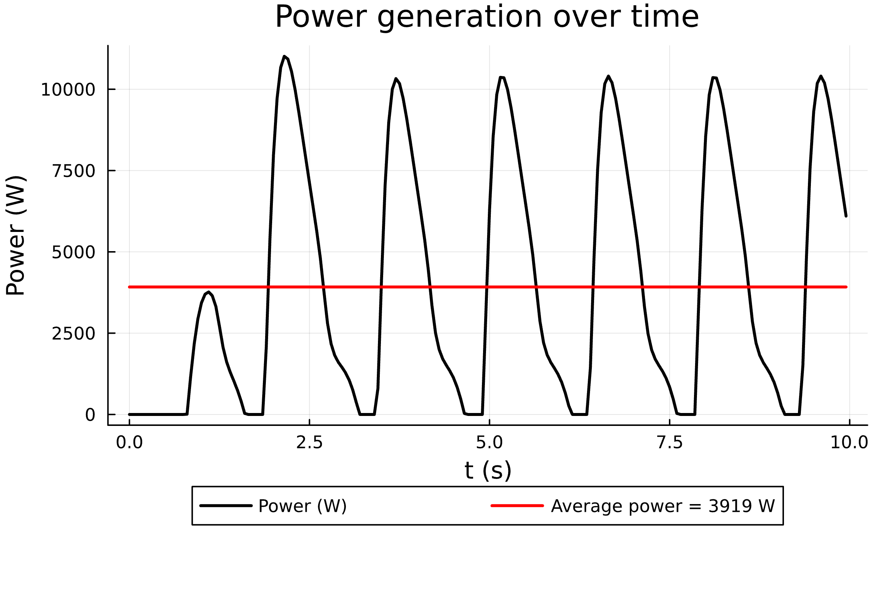
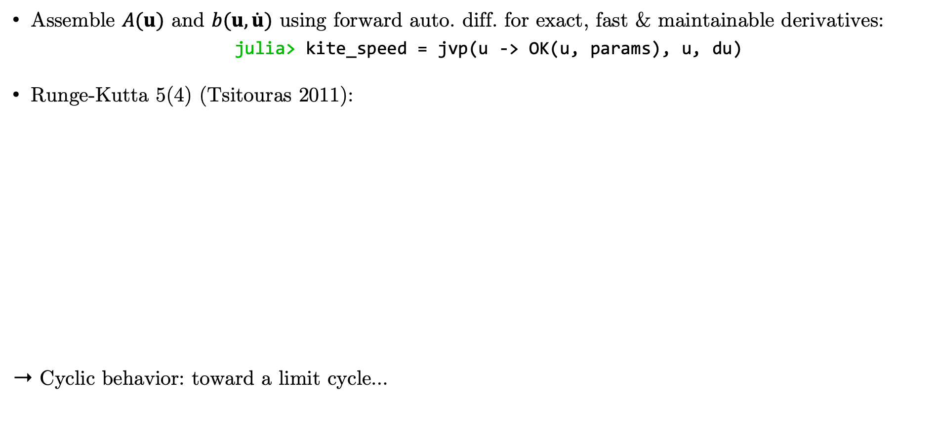
First Numerical Results
Solving the dynamics
Assemble $A(u)$ and $b(u, \dot{u})$ using forward auto. diff. for exact, fast & maintainable derivatives:
julia> kite_speed = jvp(u -> OK(u, params), u, du)
Runge-Kutta 5(4) (Tsitouras 2011):
➝ Cyclic behavior: toward a limit cycle…

Slide 15
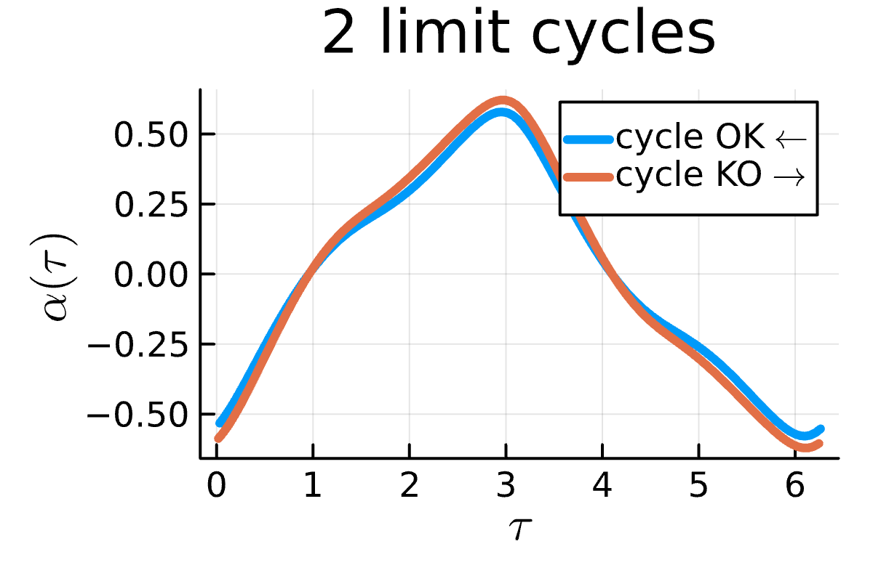
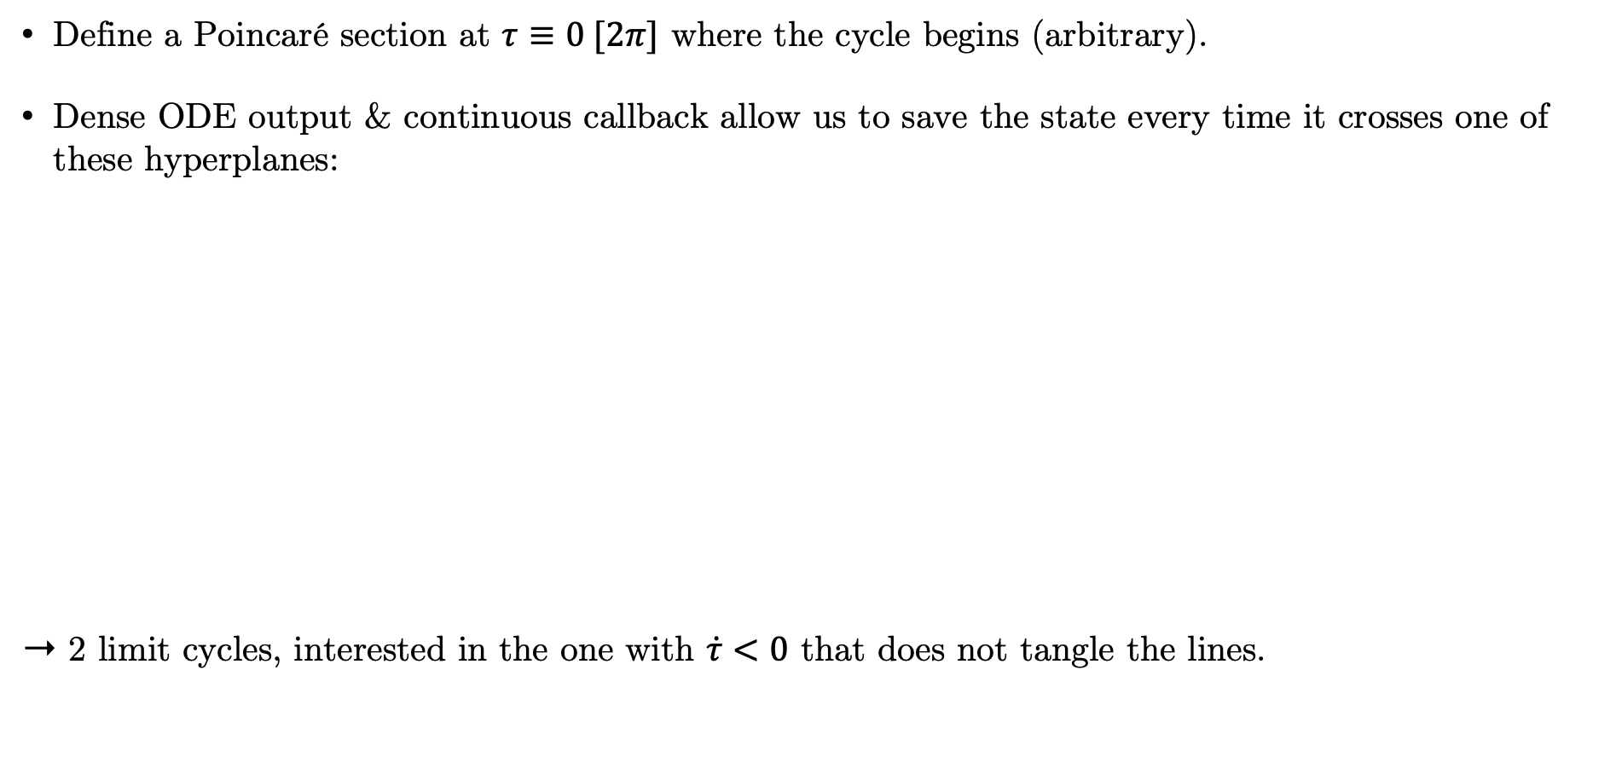
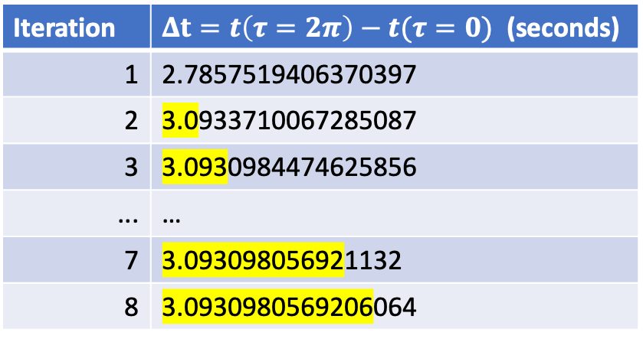
First Numerical Results
Limit Cycle
Define a Poincaré section at $τ≡0 [2π]$ where the cycle begins (arbitrary).
Dense ODE output & continuous callback allow us to save the state every time it crosses one of these hyperplanes:
➝ 2 limit cycles, interested in the one with $\dot{τ}<0$ that does not tangle the lines.
Iteration | $Δt=t\left(τ=2π\right)−t(τ=0)$ (seconds)
1 | 2.7857519406370397
2 | 3.0933710067285087
3 | 3.0930984474625856
... | …
7 | 3.093098056921132
8 | 3.0930980569206064

Slide 16
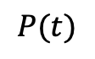
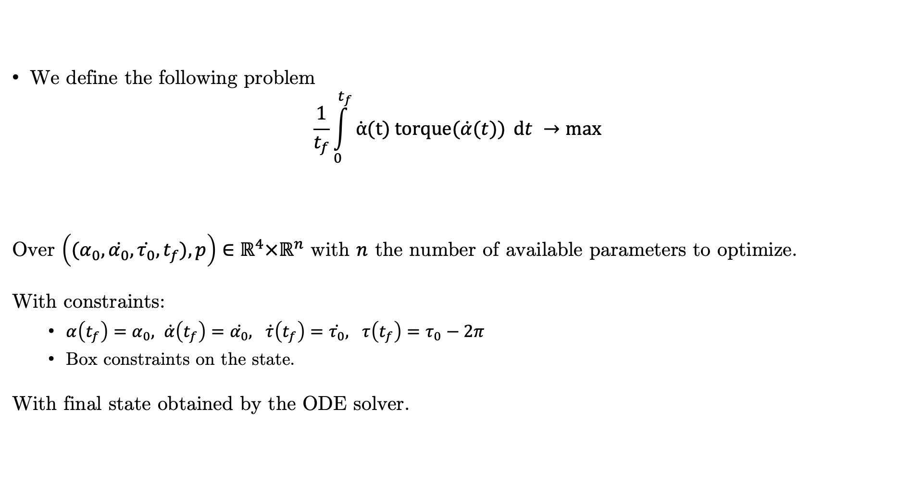
Optimization
Problem: Optimize the Average Power over a limit cycle
We define the following problem
$$\frac{1}{t_{f}}\int_{0}^{t_{f}}{\dot{α}(t) torque(\dot{α}(t))} dt →max$$
Over $\left({(α}_{0}, \dot{α_{0}}, \dot{τ_{0}}, t_{f}), p\right)∈ℝ^{4}×ℝ^{n}$ with $n$ the number of available parameters to optimize.
With constraints:
$α\left(t_{f}\right)=α_{0}, \dot{α}\left(t_{f}\right)=\dot{α_{0}}, \dot{τ}\left(t_{f}\right)=\dot{τ_{0}}, τ\left(t_{f}\right)=τ_{0}−2π$
Box constraints on the state.
With final state obtained by the ODE solver.
$$P(t)$$

Slide 17
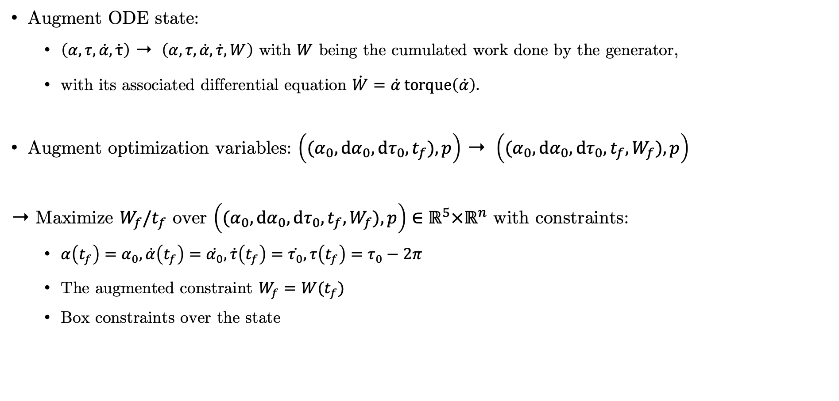
Optimization
Augmentations
Augment ODE state:
$\left(α, τ, \dot{α}, \dot{τ}\right)$ ➝ $\left(α, τ,\dot{α}, \dot{τ}, W\right)$ with $W$ being the cumulated work done by the generator,
with its associated differential equation $\dot{W}=\dot{α} torque\left(\dot{α}\right).$
Augment optimization variables: $\left({(α}_{0}, dα_{0}, dτ_{0}, t_{f}), p\right)$ ➝ $\left({(α}_{0}, dα_{0}, dτ_{0}, t_{f}, W_{f}), p\right)$
➝ Maximize $W_{f}/t_{f}$ over $\left({(α}_{0}, dα_{0}, dτ_{0}, t_{f}, W_{f}), p\right)∈ℝ^{5}×ℝ^{n}$ with constraints:
$α\left(t_{f}\right)=α_{0}, \dot{α}\left(t_{f}\right)=\dot{α_{0}}, \dot{τ}\left(t_{f}\right)=\dot{τ_{0}}, τ\left(t_{f}\right)=τ_{0}−2π$
The augmented constraint $W_{f}=W(t_{f})$
Box constraints over the state

Slide 18
Optimization
Ongoing work
Gradients and Hessians of the constraints computed with automatic differentiation
Initialization on the limit cycle, where constraints are satisfied
Use Interior Point OPTimizer (IPOPT)
➝ Look for saturated box constraints
➝ perform a sensitivity analysis around the optimal point

Slide 19
Conclusion
Solve the ODE ➝ find the limit cycle ➝ optimize on the limit cycle, thanks to Julia tools
Move forward to a controlled model, without the cone constraint
Have an engineer build a prototype that would (in)validate our results through measurements
K. Desenclos, 2022, Production d’électricité par voile de kite.

Slide 20
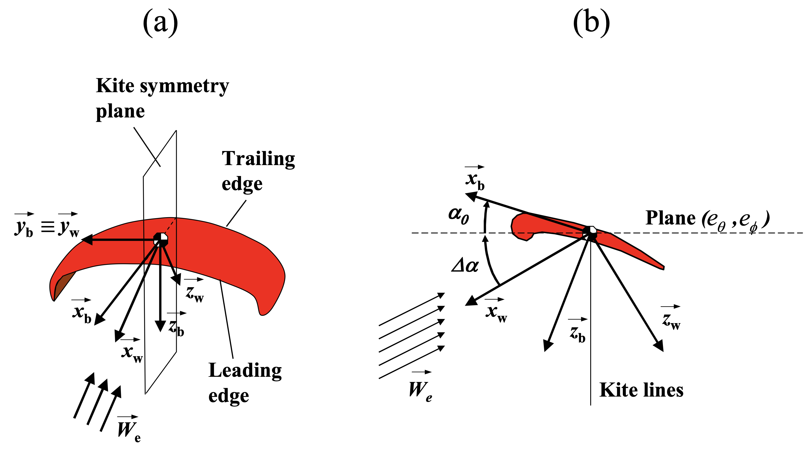
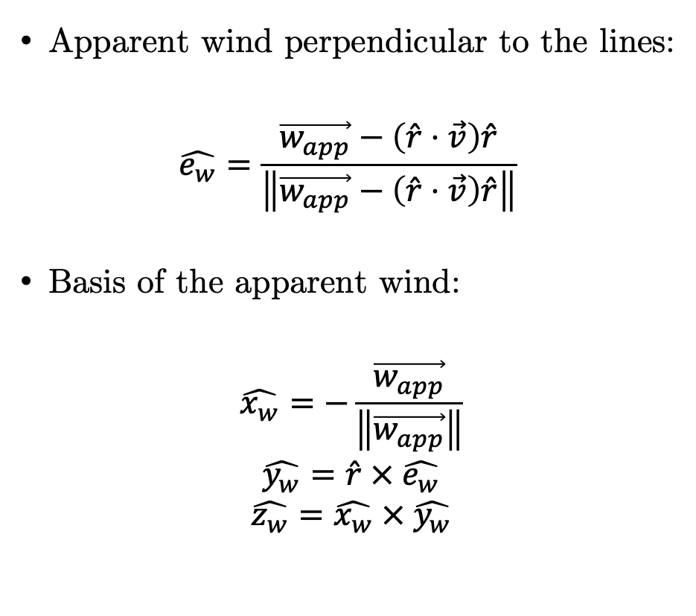
Annex 1: Basis vectors related to the local wind
Apparent wind perpendicular to the lines:
$$\hat{e_{w}}=\frac{\vec{w_{app}}−\left(\hat{r}⋅\vec{v}\right)\hat{r}}{\left\|\vec{w_{app}}−\left(\hat{r}⋅\vec{v}\right)\hat{r}\right\|}$$
Basis of the apparent wind:
$$\hat{x_{w}}=−\frac{\vec{w_{app}}}{\left\|\vec{w_{app}}\right\|}$$
$$\hat{y_{w}}=\hat{r} × \hat{e_{w}}$$
$$\hat{z_{w}}=\hat{x_{w}} × \hat{y_{w}}$$

Slide 21
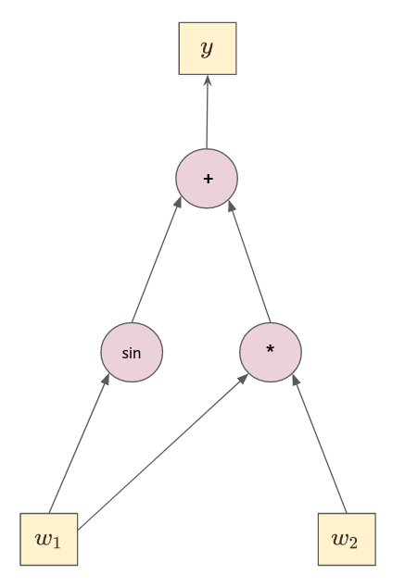
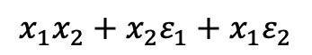
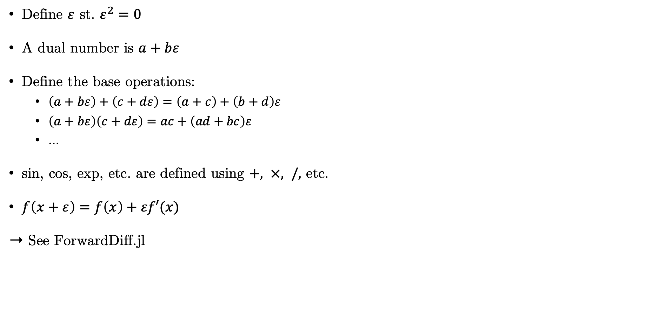
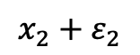
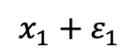
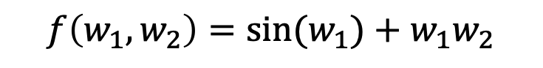
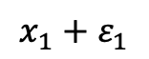
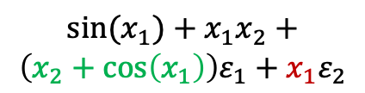
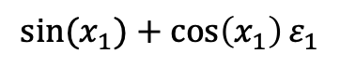
Annex 2: Forward Automatic Differentiation
$$f\left(w_{1}, w_{2}\right)={sin⁡(w}_{1})+w_{1}w_{2}$$
Define $ε$ st. $ε^{2}=0$
A dual number is $a+bε$
Define the base operations:
$\left(a+bε\right)+\left(c+dε\right)=\left(a+c\right)+\left(b+d\right)ε$
$\left(a+bε\right)\left(c+dε\right)=ac+\left(ad+bc\right)ε$
…
sin, cos, exp, etc. are defined using $+, ×, /,$ etc.
$f\left(x+ε\right)=f\left(x\right)+εf′(x)$
➝ See ForwardDiff.jl
$${sin⁡(x}_{1})+x_{1}x_{2}+$$
$$\left(x_{2}+\cos\left(x_{1}\right)\right)ε_{1}+x_{1}ε_{2}$$
$${sin⁡(x}_{1})+\cos\left(x_{1}\right)ε_{1}$$
$$x_{1}x_{2}+x_{2}ε_{1}+x_{1}ε_{2}$$
$$x_{1}+ε_{1}$$
$$x_{2}+ε_{2}$$
$$x_{1}+ε_{1}$$

